Slide 1
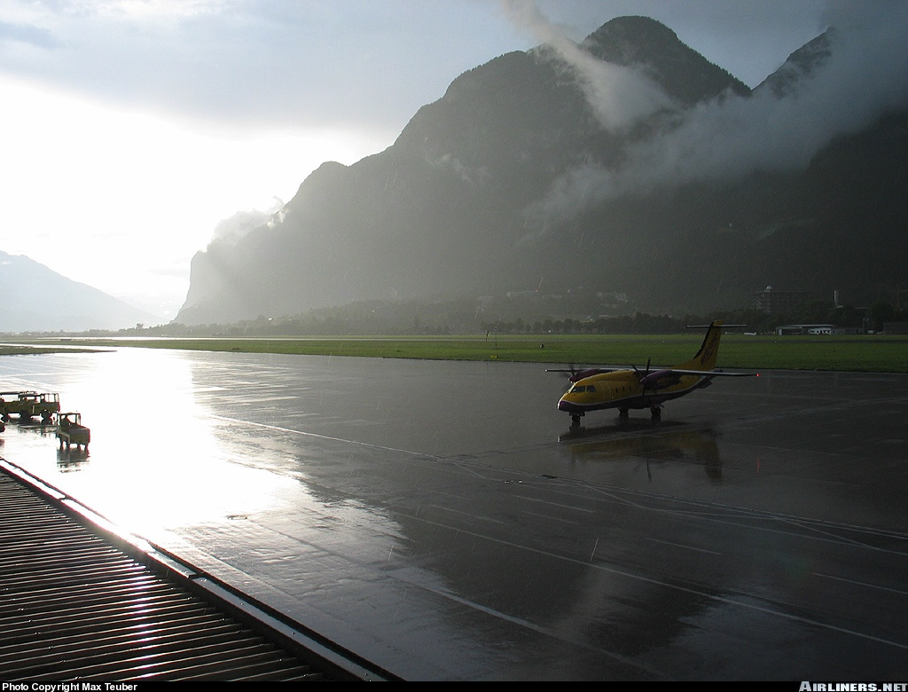
Air Masses of North America
CI Valentine
References: FTGU 29th
Pages 140 - 159
PO 403
Notes:
Writing in regular script down here is to be taught
Writing in italics is for extra information

Slide 2
Review
What are the layers of the atmosphere?
Explain convergence.
Name some clouds of vertical development
Notes:
Troposphere Stratosphere Mesosphere Thermosphere Exosphere
The inward flow of air accompanied by an upward flow as the excess air escapes
Cumulus Cumulus fractus Towering cumulus Cumulonimbus

Slide 3
Topics to be covered today
Air Masses of North America
Fronts
Clouds, Precipitation and Fog
Thunderstorms
Visibility and Ice Accretion
Turbulence and Weather Signs

Slide 4
Air Masses
Air Mass: large section of the troposphere with uniform properties of TEMPERATURE and MOISTURE in the horizontal
Classified by temperature and moisture content
Moisture:
Continental= Dry Maritime = Moist
Temperature:
Arctic = Cold Polar = Moderate Tropical = Warm
Notes:
The areas near the equator are called (E) equatorial for the hot areas of the world.
Temperature is classed by the temperature at the source of the air mass
Moisture content is classed by the humidity of the air according to whether the air originates over the continent or body of water

Slide 5
Air Masses
The temperature in an air mass is determined by where the air mass is formed:
Arctic Region
Ranges from the poles to the permafrost line
Polar Region
Extends south from the permafrost line to where the mean temperature is 10°C
Tropical Region
The area below 30°N latitude

Slide 6
Weather in an Air Mass
The weather in an air mass is determined by three factors
Moisture Content
Cooling Processes
Air Stability

Slide 7
Principal Air Masses of Canada
Continental Arctic (cA)
Forms over the Arctic regions
Remains over land as it moves south
Dry and cold
Very low tropopause
Notes:
Forms over the polar regions generally during the winter
Very stable

Slide 8
Principal Air Masses of Canada
Maritime Arctic (mA)
Forms over the Arctic regions
Absorbs moisture briefly as it moves over the North Atlantic or North Pacific
Moist and cold
Low tropopause
Notes:
Forms over Alaska or Siberia
Spends little time over the Pacific
Unstable in the lower layers

Slide 9
Principal Air Masses of Canada
Maritime Polar (mP)
Forms over the Arctic regions
Spends a longer time over water than mA
Moist and cool
Medium tropopause
Notes:
Forms over the polar region of North-central Russia
Spends considerable time over the Pacific
Unstable

Slide 10
Principal Air Masses of Canada
Maritime Tropical (mT)
Forms over the South Pacific and South Atlantic
Causes fog in the Atlantic Provinces
Moist and warm
High tropopause
Notes:
Forms over semi-tropical areas; originates from southwest (Caribbean) and southern Pacific
Forms over the Pacific or Atlantic
Rarely appears north of the Great Lakes
Highly unstable

Slide 11
Principal Air Masses of Canada
CAPT
ontinental Arctic
Maritime rctic
Maritime olar
Maritime ropical
Notes:
The reason that cP is not included is because Canada lacks the widespread dry polar region required for the formation of this air mass. The terrain features of North America are such that cP air is not found in Canada but is found elsewhere in the world including the United States. cA that moves south over the United States is warmed from below and modifies into cP.
The source area for cT air is very small in North America, so this air mass is only occasionally found in Canada.

Slide 12
Characteristics of Air Masses
Cold Air Masses
Inherently stable but heating from below causes instability
Turbulent
Good Visibility
Cumuliform Cloud
Showery Precipitation
Thunderstorms may occur

Slide 13
Characteristics of Air Masses
Warm Air Masses
Stable
Smooth/calm air
Poor Visibility
Stratiform Cloud
Steady Precipitation

Slide 14
Modification
Air mass characteristics are modified as they move over different surfaces
If the modification is extensive, the air mass may be given a new name
Example:
mA air mass modified to mP as temperature moderates
Notes:
As the temperature warms in the springtime in North America, the Arctic air masses tend to remain further north and not extend to the heavily populated areas of Canada or the United States. The rising temperature and the melting snow transform the Arctic air mass into a Polar air mass

Slide 15
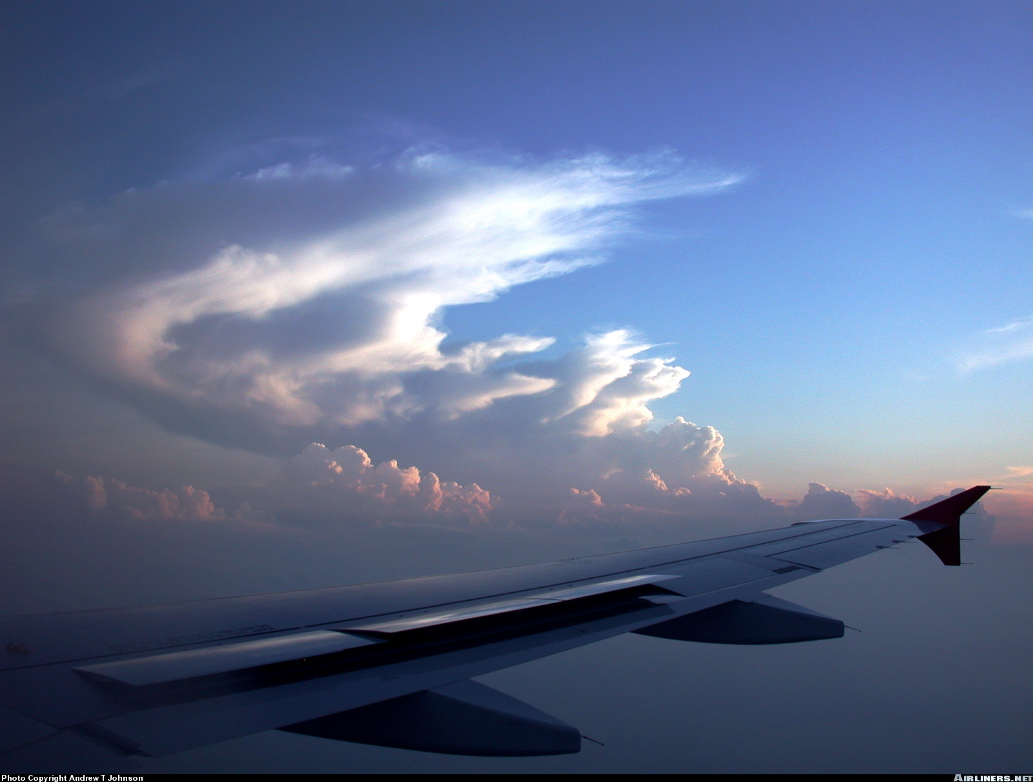
Fronts
Notes:
Frontal formation:
According to the direction of the prevailing winds, winds developing in the cold air mass will come from the east and winds developing in a warm air mass will come from the west. The warm air mass to the south tends to push into the cold air to the north; the cold air mass to the north also tends to push into the warm air to the south. The combination of these tendencies creates a counter-clockwise rotating motion. A depression (the polar depression) is thus created and grows steadily.
Fronts are created and intensify in the polar depression. See From the Ground Up, page 130 (141 millenium edition) for the diagrams

Slide 16
What is a Front?
Front
Narrow transition zone between two air masses
Sloping side of the cold air is called the frontal surface
The weather at a front is determined by the characteristics of the warm air that is being lifted and the degree of lift
Notes:
Frontolysis: the transition zone between two air masses enlarges and diffuses (the front dissipates). A front which diminishes in intensity.
Frontogenesis: the transition zone between two air masses becomes more abrupt and well defined (the front is formed). A front which increases in intensity

Slide 17
Cold Fronts
A cold front is a front in which the cold air is advancing
Cold fronts have very steeps slopes (approximately 1:50)
They produce a narrow but intense band of weather
Notes:
When a mass of cold air overtakes a mass of warm air, the cold air being denser stays on the surface and undercuts the warm air violently. Surface friction tends to slow down the surface air while the upper air, not being subject to the friction, retains its speed and tends to catch up. As a result, the slope of the advancing cold front is quite steep.
Plane of the frontal surface: 1 mile high/50 miles long (steep slope)

Slide 18
Cold Fronts
Clouds and Weather
Showery Precipitation
Low ceiling and clouds of vertical development
Winds veer with frontal passage
Temperature drops with frontal passage
Fast moving Cold Fronts can produce thunderstorms and/or squall lines
Notes:
Visibility improves after the passage of the front
Turbulence: difficult flying conditions

Slide 19
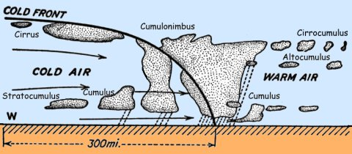
Cold Fronts

Slide 20
Warm Fronts
A warm front is a front in which the cold air is retreating
Warm fronts have relatively shallow slopes (approximately 1:200)
They produce a wide band of weather than can cover up to 500 miles
Precipitation may lead the front by as much as 200 miles
Notes:
As a mass of warm air advances on a retreating mass of cold air, the warm air, being lighter, ascends over the cold air in a long gentle slope

Slide 21
Warm Fronts
Clouds and Weather
Steady Precipitation; strong as front passes
Low ceiling with stratiform cloud
Winds veer gradually with frontal passage
Temperature rises gradually with frontal passage
Thunderstorms may be embedded in stratus cloud
In winter, ice pellets and Freezing Rain may precede the front
Notes:
Visibility is reduced
Turbulence is light

Slide 22
Warm Fronts
The progression of cloud types preceding a warm front is very distinctive and can be remembered by using the acronym:
C – cirrus
C – cirrostratus
A – altostratus
N – nimbostratus
S – stratus

Slide 23
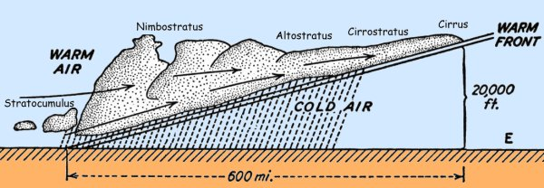
Warm Fronts

Slide 24
Occluded Fronts
Occurs when a cold front overtakes a warm front and lifts the warm air off the ground
In Canada, this is known as a TROWAL (TRough Of Warm air ALoft)
Weather depends on if the air being overtaken is colder then the air overtaking
Generally unsettled conditions due to the lifting action provided by the two fronts
Notes:
Same characteristics as a warm front with a chance of cumulonimbus developing if the warm air is unstable and moist enough
Occluded warm front (warm occlusion):
-over the distance it has covered, the cold air may have undergone a transformation, becoming less cold than the cold air it catches
-cool air catches up to cold air
-creates a TROWAL
-same characteristics as a warm front with a chance of cumulonimbus developing if the warm air is unstable

Slide 25
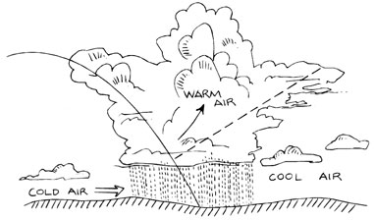
Occluded Fronts
Notes:
Stationary Front: an area in which the cold air is neither advancing nor retreating
Upper front: in Canada, the term upper front refers to a non-occlusion situation. Sometimes cold air advancing across the country may encounter a shallow layer of colder air resting on the surface or trapped in a topographical depression. The advancing cold air rides up over the colder, heavier air. A station on the ground will not feel any temperature change or winds but will observe the cloud and precipitation associated with the front present at altitude.

Slide 26
Review
What is an air mass?
How are air masses classified?
What are the three types of fronts?
Notes:
Large segment of the troposphere with uniform properties of temperature and humidity in the horizontal
Temperature: Arctic Polar Tropical Moisture: Continental Maritime
Cold front Warm front Occluded front

Slide 27
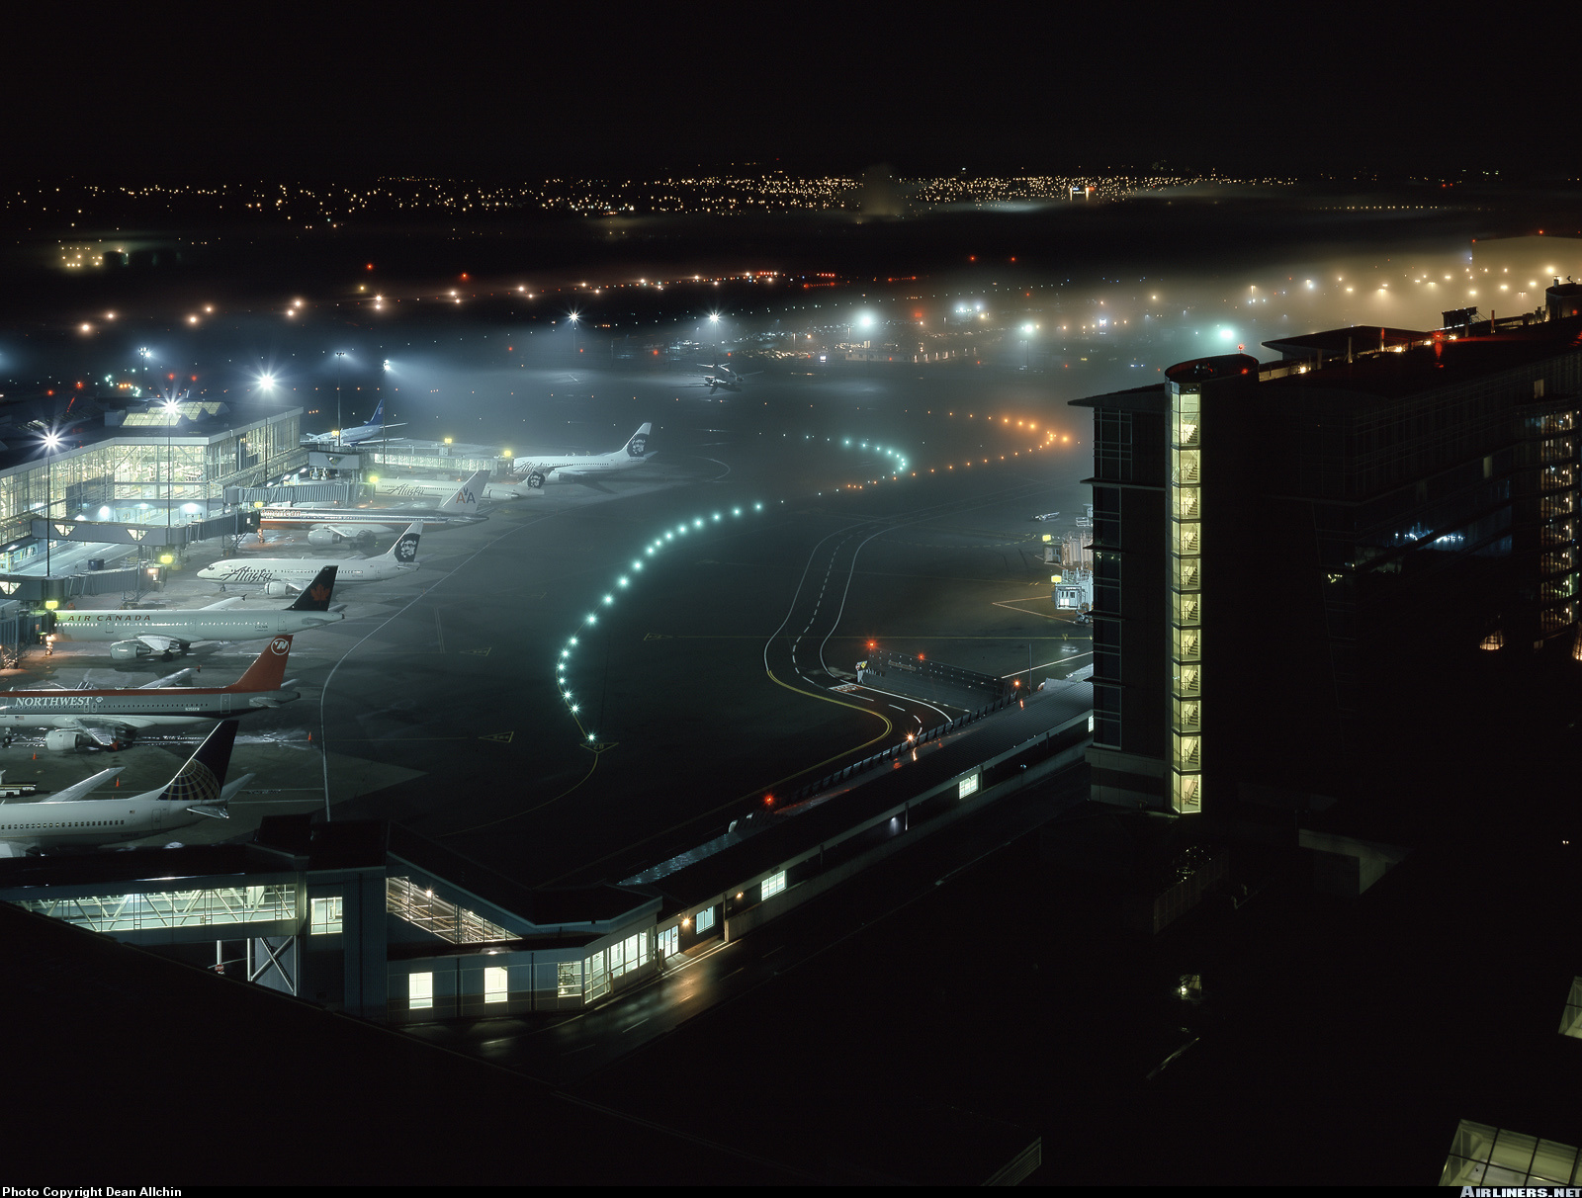
Clouds, Fog & Precipitation

Slide 28
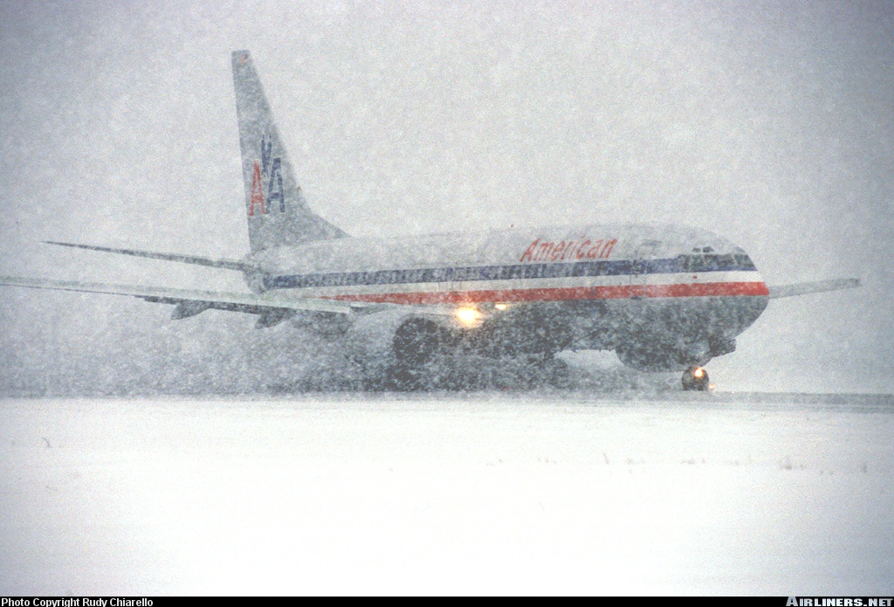
Precipitation

Slide 29
Precipitation
Precipitation occurs when water droplets in a cloud grow too heavy for the vertical currents to support them
Common forms of precipitation include:
Drizzle
Rain
Freezing Drizzle
Freezing Rain
Hail
Snow Pellets
Snow
Ice Prisms
Ice Pellets
Notes:
In a cloud where the temperature is above the freezing point, vertical currents stir the water droplets, causing them to collide and combine into progressively larger drops. The droplets acquire inertia and finally fall as rain. This process is called coalescence.
Clouds which form at temperatures well below the freezing point are generally composed of small particles of frozen water called ice crystals. These crystals form directly from water vapour through sublimation.
Drizzle: tiny water droplets which seem to be suspended in the air
Rain: fat water drops
Hail: hard and transparent layer of ice covering a core of soft ice
Snow pellets (soft hail): soft white ice, like a hailstone nucleus without the hard cover
Snow: agglomeration of ice crystals formed by sublimation
Ice prisms: tiny ice crystals in the form of needles
Ice pellets/ frozen rain drops: hard, transparent globular grains of ice

Slide 30
Precipitation and Cloud Type
Precipitation Type | Cloud Type
Drizzle, freezing drizzle, snow grains | Stratus and stratocumulus
Snow or rain (continuous) | Thick altostratus and nimbostratus
Snow or rain (intermittent) | Thick altostratus and stratocumulus
Snow showers, rain showers | Altocumulus, heavy cumulus, cumulonimbus
Hail, ice pellet showers | Cumulonimbus
Ice pellets (continuous) | Any rain cloud (below freezing)
Ice Prisms | No cloud necessary
Snow pellets | Heavy cumulus
Notes:
Turbulence is most severe in cumuliform clouds which produce showery precipitation

Slide 31
Review
What conditions do clouds need to form?
What are some lifting agents?
What are some types of precipitation?
Notes:
High relative humidity Condensation nuclei Cooling process/lifting agent
Orographic lift Frontal lift Convection Convergence Mechanical Turbulence
Drizzle Rain Hail Snow pellets Snow Ice prisms Ice pellets

Slide 32
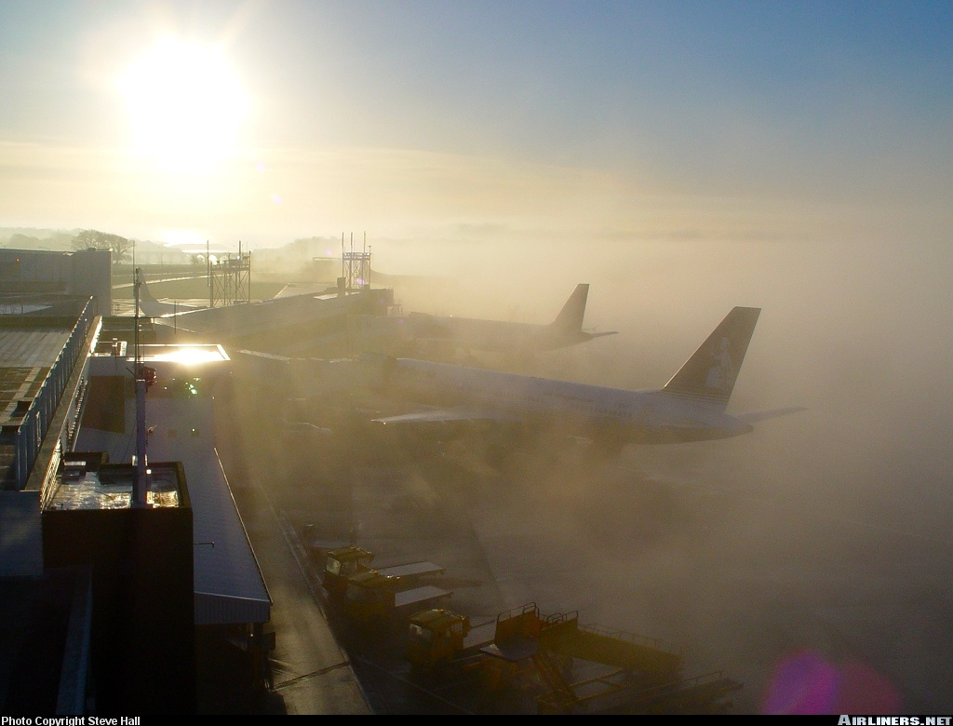
Fog

Slide 33
What is Fog?
Fog is a cloud (usually stratus), in contact with the ground
Fog forms in two ways:
1. The air is cooled to below the dew point and the water vapour condenses
2. Water vapour is added to the air until the air becomes saturated
Notes:
Risk of fog is to be considered when surface temperature is less than 2 degrees from the dew point temperature
Fog formed by cooling: radiation, advection, upslope
Fog formed by addition of humidity: steam, precipitation, ice
Frontal fog is formed by both cooling and addition of humidity

Slide 34
RAPSUI

Slide 35
Types of Fog
Radiation Fog
Clear nights
Light winds
High relative humidity
As the earth cools, it also cools the air in contact with it
When the air is sufficiently cooled, the water vapour condenses and fog appears

Slide 36
Types of Fog
Advection Fog
Forms when warm air moves over a cold surface
Can be very extensive
Upslope Fog
Forms when air is cooled due to expansion as it moves up a slope
A light upslope wind is necessary
Notes:
Advection fog:
Can form in winds exceeding 15mph

Slide 37
Types of Fog
Steam Fog
Forms when cold air moves over a warm water surface
Evaporation of the water occurs until the air is saturated
Excess water vapour then condenses as fog

Slide 38
Types of Fog
Frontal Fog
Warm frontal fog occurs when the cold air becomes saturated by rain falling from the warm air above
Precipitation Fog
Occurs when the air is saturated by excessive amounts of rain or drizzle

Slide 39
Types of Fog
Ice Fog
Occurs at very low temperatures when a large amount of moisture is suddenly introduced into the air
The most common version of this is the contrails produced by the engines of airliners flying at high altitude

Slide 40
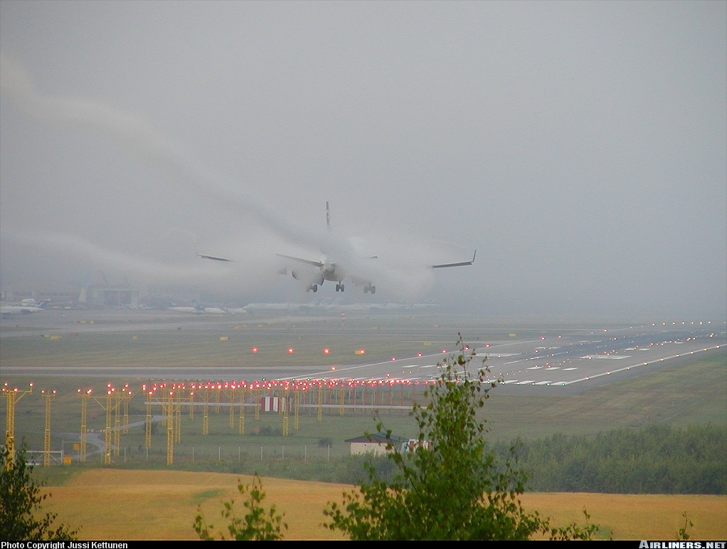
Visibility

Slide 41
Visibility
Visibility is one of the most important weather factors when it comes to aircraft operations
It is visibility, along with cloud height, that determines if an airport is open and if VFR aircraft can operate
Poor visibility affects the pilot’s ability to safely maneuver the aircraft, navigate and avoid other aircraft
Notes:
Visibility: term used to describe the transparency of the atmosphere; distance at which prominent objects may be seen and identified by day and prominent lighted objects by night

Slide 42
Restrictions to Visibility
Common restrictions to visibility include:
Cloud
Precipitation
Fog (FG)
Haze (HZ)
Smoke (FU)
Mist (BR)
Volcanic Ash (VA)
Blowing Snow (BLSN)
Blowing Dust (BLDU)
Blowing Sand (BLSA)
Notes:
Haze: tiny water droplets and particles of dust which create a uniform veil over the sky. Smoke is caused by industrial pollutants and vehicle exhaust. Haze is encountered above all in urban areas when the air is very stable.

Slide 43
Visibility vs. Stability
The stability of the air directly affects visibility
Stable air generally has poor visibility because impurities in the air are trapped in the lower levels
Stable air is also associated with cloud that produces drizzle and steady rain
Unstable air generally gives good visibility, but the gusty winds that are associated with it can cause blowing snow or dust

Slide 44
Types of Visibility
Visibility - The distance at which prominent objects may be seen and identified by day
Flight Visibility - The range of visibility forward from the cockpit of an aircraft in flight
Slant Range Visibility - The distance a pilot of an aircraft in flight can see along the ground
Ground Visibility - The visibility observed at an airport by an accredited observer
Prevailing Visibility - The distance at which known objects are visible over at least half the horizon
Notes:
Ground Visibility: The visibility at an aerodrome as contained in a weather observation reported by: (a) an Air Traffic Control (ATC) unit; (b) a Flight Service Station (FSS); (c) a Community Aerodrome Radio Station (CARS); (d) a radio station that is ground-based and operated by an air carrier; or (e) an Automated Weather Observation System (AWOS).

Slide 45
Types of Visibility
Runway Visual Range (RVR) - The distance a pilot can see down a specific runway
This is measured by a device located beside the runway, called a transmissometer
RVR values are given in feet, and are reported if the RVR is less than 6000 feet or if the prevailing visibility is less than 1 SM
RVR is very important as it determines whether a pilot can attempt an instrument approach at some airports

Slide 46
VMC and IMC
Visual Meteorological Conditions (VMC)
Visibility, distance from cloud and ceiling are equal or greater than VFR minima
Instrument Meteorological Conditions (IMC)
Visibility, distance from cloud and ceiling are below minima and flight can only be conducted under IFR

Slide 47
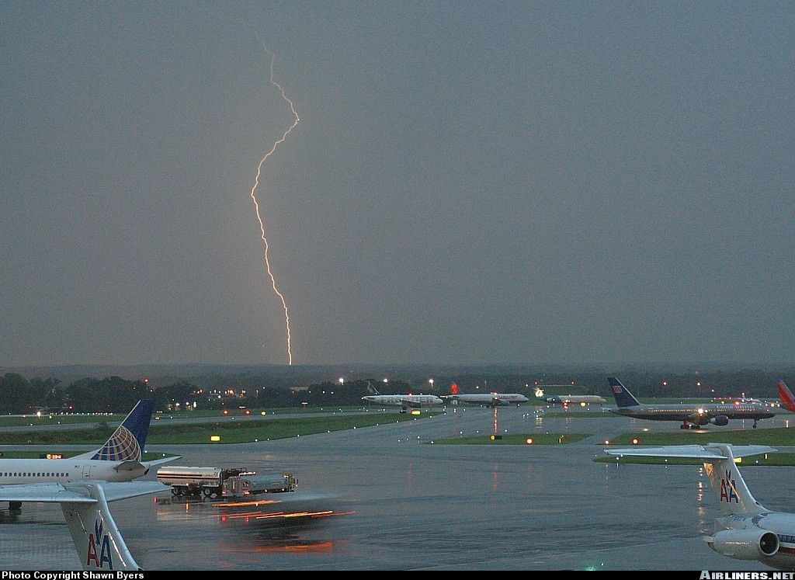
Thunderstorms

Slide 48
Thunderstorms
Thunderstorms are a weather phenomena that present a severe weather hazard to aviation
Dangerous conditions associated with thunderstorms include:
Poor visibility
Icing
Thunder
Lightning
Strong vertical drafts
Severe gusts and turbulence
Heavy rain
Hail
Micro/macro bursts
Tornadoes
Severe wind shear
Notes:
Altimeter errors:
Thunderstorms are concentrated low pressure areas; the local fluctuations in barometric pressure mean the altimeter is unreliable
Tornado:
Violent rotating depression, associated with severe thunderstorms
Very deep, concentrated depressions
Resemble funnels suspended under a cumulonimbus; have a dark colour due to the dust and debris suspended in the vortex
Very high winds (up to 300 kts)
Rotates 99% of the time counterclockwise (some clockwise tornados in the USA have been spotted on rare occasions)

Slide 49
Thunderstorms
Conditions required for thunderstorm development are
1. Unstable air to high levels
2. High relative humidity
3. Lifting agent:
Convective, Orographic or Frontal

Slide 50
The Life Cycle of a Thunderstorm
Initial or Cumulus Stage
Strong updrafts (unstable air to high levels)
Temperature in cloud is higher than surrounding air
Diameter ranges from 1 to 2 miles, but can be as great as 6 miles
Steep lapse rate

Slide 51
The Life Cycle of a Thunderstorm
Mature Stage
Updrafts penetrate to great heights
Downdrafts begin in middle and lower levels of the cell
Start of precipitation at the surface
Usually lasts 15 to 30 minutes, but can last as long as 60 minutes

Slide 52
The Life Cycle of a Thunderstorm
Dissipating Stage
Downdrafts occupy all but very top of cell where updrafts continue
Precipitation slows and then stops
Top of cloud forms anvil shape

Slide 53
Types of Thunderstorms
There are two main types of thunderstorm:
Air mass thunderstorms
Usually form singly or in clusters on hot summer days
Relatively easy to avoid
Convective or Orographic lift

Slide 54
Types of Thunderstorms
Frontal thunderstorms
Usually form due to a fast advancing cold front, but are possible with warm fronts as well
Form in lines along the front that can be hundreds of miles long
Often embedded in other clouds making them impossible to avoid without RADAR or Stormscope
A fast moving, violent line of storms ahead of a cold front is known as a Squall Line
Notes:
Squall line: long line of thunderstorm cells accompanying the passage of a rapid cold front. Hazards associated with a squall line are similar to those of a thunderstorm but squall lines are harder to dodge since they are much larger systems. The only options are to fly away or to land before the system hits the region.

Slide 55
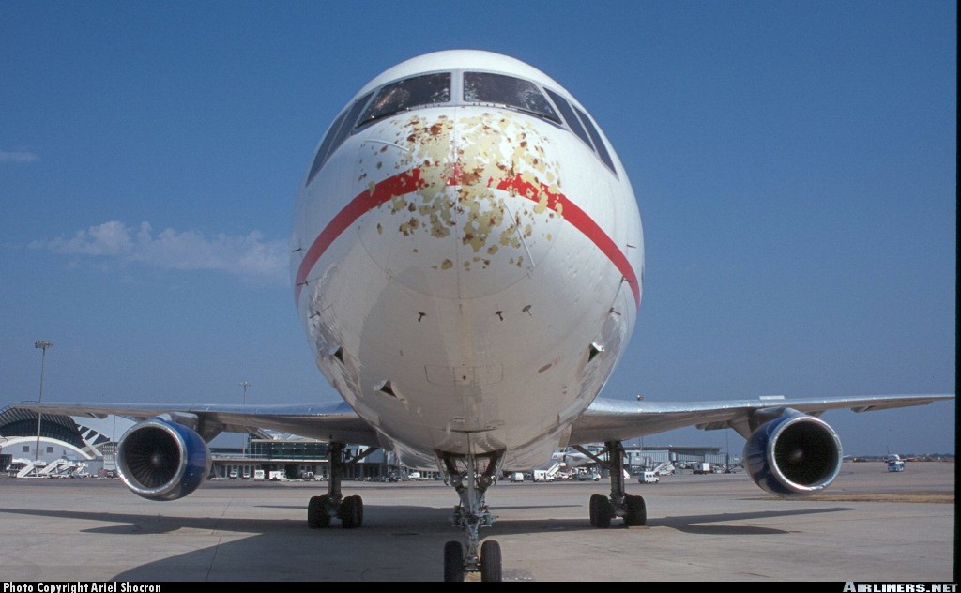
Thunderstorm Hazards

Slide 56
Thunderstorm Hazards
Turbulence
Can cause overstressing of the aircraft and loss of control
Downdrafts as strong as 2000 feet per minute and updrafts as strong as 6000 feet per minute may be encountered (microburst)
Strongest between 12,000 and 20,000 feet in cloud
Can be expected in clear air, up to 20 miles away from a thunderstorm
Can be severe in microbursts and macrobursts near the gust front

Slide 57
Thunderstorm Hazards
Winds
Danger of gusts up to 80 kts. With rapid changes in direction
The gust front generates strong, gusty winds near the surface which can change direction by 180° and gust up to 50 kts. In a matter of second
Hail
Can cause serious structural damage
Can be encountered outside of cloud as it is thrown upward and outward by active cells

Slide 58
Thunderstorm Hazards
Lightning
Can hamper vision for 30-50 seconds at a time
The greatest likelihood of a strike is at temperatures between -5°C and +5°C
Solid state circuitry is particularly vulnerable to strikes
Electrical devices may be disrupted or damaged
Possibility of igniting fuel vapour in the fuel cells
Notes:
Heavy rain can cause contamination of the wing surface and lead to an unexpected stall
Rain reduces visibility

Slide 59
Thunderstorm Hazards
Icing
Cells contain an abundance of supercooled water droplets, which can cause severe icing
Icing is most severe during the mature stage
Pressure
Rapid pressure changes can cause unreliable altimeter readings
Notes:
Super-cooled water droplets: droplets of liquid water, which remains liquid at temperatures significantly below the freezing point.

Slide 60
Thunderstorm Avoidance
The best advice on flying through a thunderstorm is - DON’T
If you must pass by one, stay at least 15 miles away and pass to the right
Thunderstorms are areas of low pressure and therefore rotate counter-clockwise
You will encounter a tailwind if you pass to the right, getting you past the danger more quickly
NEVER FLY UNDER A THUNDERSTORM, EVEN IF YOU CAN SEE THROUGH TO THE OTHER SIDE
Notes:
Do not fly through a thunderstorm
Avoid taking off or landing near thunderstorms
Do not fly under a thunderstorm
Reduce your speed to manoeuvring speed at the first sign of turbulence
Stay at least 10-15 miles away and on the right-hand side of the CB. As a pilot, avoiding flying near a thunderstorm is safest procedure to follow. A thunderstorm is a highly concentrated area of low pressure (counter-clockwise and inward airflow). You will encounter favourable winds flying around the right-hand side of a thunderstorm cell.

Slide 61
Review
What are the types of fog?
What are the three stages of a thunderstorm?
How do you avoid a thunderstorm?
Notes:
Radiation Advection Precipitation Steam Upslope Ice
Initial/cumulus Mature Dissipating
Do not fly through thunderstorms Avoid taking off or landing near thunderstorms Do not fly under a thunderstorm Reduce to manoeuvring speed at first sign of turbulence Stay 10-15 miles away on the right of the CB

Slide 62
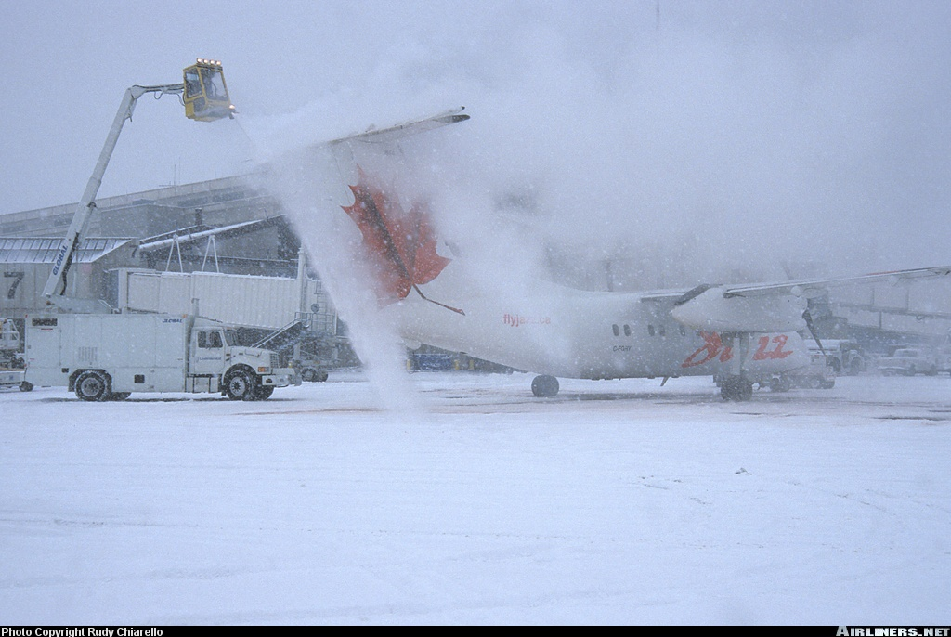
Icing

Slide 63
Icing
In conditions slightly below freezing, supercooled water droplets may exist in cloud
These supercooled water droplets are water that remains in a liquid form below 0°C
When these droplets strike the aircraft, they freeze, adding weight and drag to the aircraft
Dangerous icing can occur in cloud, freezing rain, or freezing drizzle
Notes:
Dangers associated with icing:
Controls: reduces lift and therefore effectiveness; ice can black the controls
Wings: modifies the shape of the wing; destroys laminar airflow by provoking transition; increases weight. The stall speed increases.
Windscreen: reduced visibility
Antennae: may black transmission
Pitot and static ports: obstructs the ports

Slide 64
Types of Icing
Rime Ice
An opaque, milky white ice
Forms by the instantaneous freezing of small supercooled water droplets
Has no great weight
Alters the shape and aerodynamic characteristics of the aircraft
Can obscure intake, carburetors, and static and pitot ports
Is very brittle and easily removed by de-icing equipment
Notes:
Accumulates on the leading edges of the wings and on antennae

Slide 65
Types of Icing
Clear Ice
A coating of glassy ice
Forms as large supercooled water droplets spread and freeze slowly
Can form a strong, solid sheet of ice which is difficult to dislodge
Increases the weight of the aircraft
Alters the aerodynamic characteristics of the aircraft
Can increase drag 300%-500%
When dislodged, large chunks can damage the aircraft
Unequal load can lead to vibrations
Notes:
Forms on all surfaces

Slide 66
Types of Icing
Hoar Frost
A white, feathery, crystalline formation which covers the whole aircraft
Forms by sublimation on cold, clear nights
Must be removed before takeoff as it can increase stall speed and reduce lift
Can form when an aircraft that has been in cold temperatures for a long period enters warmer air
May obscure vision by coating the windscreen
Notes:
When the dewpoint is below the freezing point, water vapour transforms directly to solid ice crystals by sublimation and accumulates on all surfaces

Slide 67
Types of Icing
Frozen Dew
Clear and slightly crystalline
Dew sometimes forms on aircraft parked outside at night
If the aircraft’s skin temperature falls below freezing, this dew will freeze
Must be removed before takeoff

Slide 68
Intensity of Icing
Light, moderate and severe icing occurs
Rate of catch: amount of water intercepted by an aircraft in a given amount of time
the number of droplets hitting the aircraft increases with speed
A thin wing captures more droplets than a thick wing
Therefore the rate of catch is higher for a thin wing flying at high speed

Slide 69
Icing Protection
Heaters
Electric heaters can be installed in the pitot tube, on the leading edged of the wings and tail, on the propellers, and on the windscreen
Inflatable Boots
Boots located along the leading edged are inflated with hot air, causing ice to be dislodged
Fluids
Some aircraft can secrete fluid over the wings, tail, and windscreen through tiny holes

Slide 70
Aircraft Surface Contamination
Weight: remove ice and snow
Critical Surfaces: wings, control surfaces, rotors, props, stabs, etc.
Water: accumulation in ports
Pre-flight Inspection: extra vigilance
Notes:
Weight: Accumulation due to snow and ice. Remove even if no flight is planned. Never assume that snow will blow off during take-off; it may even compact into ice during flight. Weight is not the real problem as ice/snow build up will seldom put the aircraft over its total weight limit. The real danger is the change in flight characteristic of the airplane. Containments will decrease lift and increase drag as well as modify flight characteristics in an unpredictable way that could potentially be disastrous.
Critical Surfaces: of an aircraft means the wings, control surfaces, rotors, propellers, horizontal stabilizers, vertical stabilizers or any other stabilizing surface on an aircraft and, in the case of an aircraft that has.
Water: Accumulated water in the static and pitot ports, ventilation port, air intakes may freeze, causing malfunctions.
Pre-flight Inspection: Do not let cold temperatures prevent you from performing a thorough inspections; indeed extra vigilance is required.

Slide 71
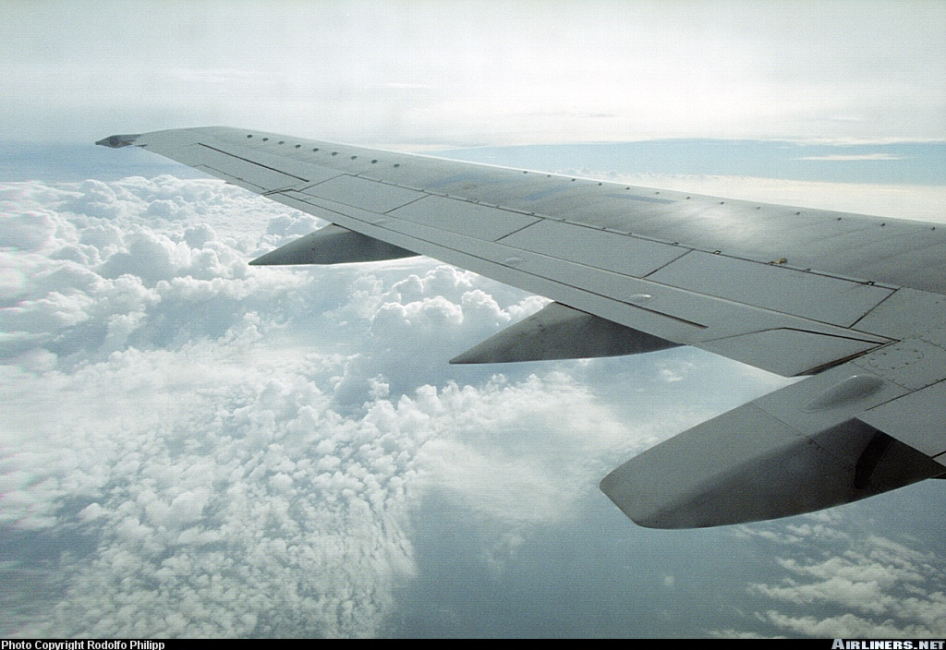
Turbulence

Slide 72
Turbulence
Turbulence is caused by the irregular motion of air
This irregular motion causes eddies and vertical currents that are felt as bumps in the aircraft
Turbulence can be severe enough to cause structural damage and/or loss of control

Slide 73
Types of Turbulence
Mechanical Turbulence
Friction between the air and the ground, especially rough or built up ground, causes eddies and vertical currents in the air
Convective (Thermal) Turbulence
Caused by uneven heating of the earth’s surface
This uneven heating causes columns of rising hot air
Clear Air Turbulence (CAT)
High level turbulence associated with jet strems

Slide 74
Types of Turbulence
Frontal Turbulence
The lifting of the warm air by the frontal surface and the friction between the two air masses results in turbulence
Wind Shear
Rapid and drastic changes in wind speed and direction
When wind shear is present, severe turbulence can be expected
Notes:
Wind shear is the sudden « tearing » or « shearing » effect encountered along the edge of a zone in which there is a violent change in wind speed and /or direction. The effect on aircraft performance of encountering wind shear derives from the fact that the wind can change much faster than the airplane mass can be accelerated or decelerated. Severe wind shear can impose penalties on an aircraft’s performance that are beyond its capacity to compensate, especially during the critical landing and take-off phases of flight.
Sources of wind shear near the surface.
Frontal Wind shear: Wind shear is usually a problem only in fronts with steep wind gradients. If the temperature difference across the front at the surface is 5°C or more, and if the front is moving at a speed of 30 kts or more, wind shear is likely to be present. Whatever which direction the front is crossed; the wind direction change will always require a course correction to the right.
Low-level wind shear: Associated with thunderstorms. Low-level wind shear is the result of two phenomena, the gust front and downdrafts. Strong downdrafts develop during the maturing phase of the thunderstorm, striking the ground and spreading out horizontally along the surface well in advance of the thunderstorm itself. Winds can change 180° and reach speeds as great as 100 kts as far as 10 miles ahead of the storm.
Temperature inversions (low-level jet stream: Overnight cooling creates a temperature inversion a few hundred feet above the ground that can produce significant wind shear, especially if the thermal inversion is coupled with the low-level jet stream. This wind shear is at its most severe shortly after midnight and dissipates as daytime heating eliminates the inversion.
Jet Stream: Sheets of strong winds, generally between 100 and 125 kts and possibly reaching 250 kts in speed. The jet stream exists in the upper atmosphere, between 20 000 and 40 000 ft (or above).
Surface Obstructions: The irregular or turbulent flow of air around mountains and hills, and through mountain passes causes serious wind shear problems for aircraft approaching to land at airports near mountain ridges.

Slide 75
Classification
The severity of turbulence can be classified by the following system
Light
Momentarily causes slight changes in altitude or attitude
Occupants may feel a slight strain against their seat belts
Moderate
Occupants will feel a definite strain against their seat belts and unsecured objects will be dislodged

Slide 76
Classification
Severe
Causes large changes in altitude and attitude, and large variations in indicated airspeed
The aircraft may momentarily be out of control and occupants will be forced violently against their seat belts
Extreme
Aircraft is tossed about violently and is impossible to control
May cause structural damage and injury to occupants

Slide 77
Review
What is flight visibility?
Name the types of icing
What is wind shear?
Notes:
Average range of visibility at any given time forward from the cockpit of an aircraft in flight
Rime ice Clear ice Hoar frost Frozen dew
Changes of wind speed and direction with altitude

Slide 78
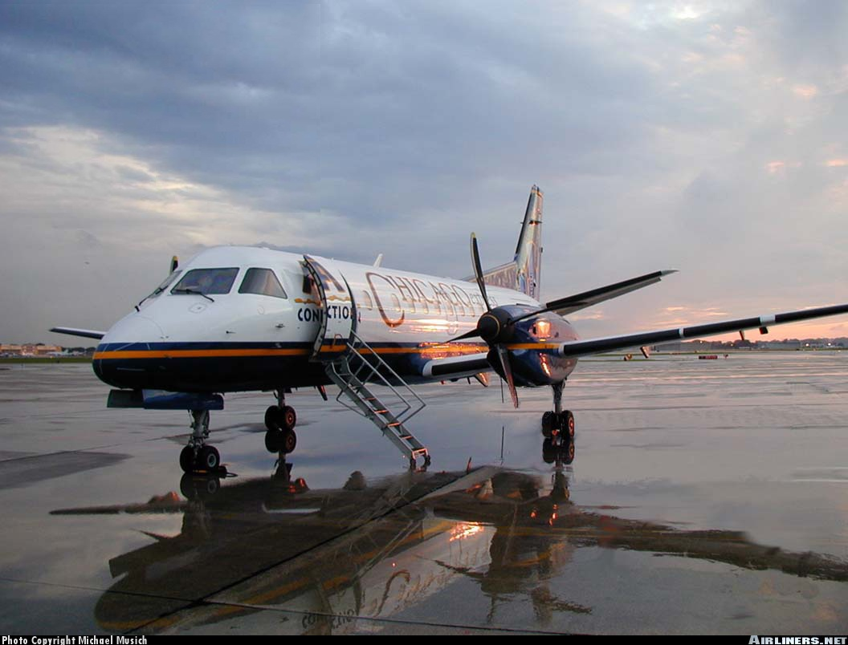
Weather Signs

Slide 79
Weather Signs
Look for Unsettled Weather When…
The pressure is falling
The temperature at night is higher than usual
Clouds move in different directions at different altitudes
Cirrus clouds increase
A large ring appears around the sun or moon and remains until overcast clouds thicken
Summer afternoon clouds darken

Slide 80
Weather Signs
Look for Steady Precipitation When…
There have been signs of unsettled weather
The wind is southeast to northeast and the pressure is falling
The more rapidly it is falling, the sooner the precipitation
Look for Showers When...
Cumulus clouds develop in a westerly wind
Cumulus clouds develop rapidly in the early afternoon during the spring or summer

Slide 81
Weather Signs
Look for Clearing Weather When…
The pressure rises
The wind shifts to the west or northwest
The temperature falls

Slide 82
Weather Signs
Look for Continued Clear Weather When…
The sun sets like a ball of fire
The pressure is steady or rising slowly
Cloudiness decreases after 3 or 4 PM
Morning fog breaks within two hours after sunrise
There is a light breeze from the west or northwest
There is a red sunset

Slide 83
Review
What are the Canadian Air masses?
What clouds indicate the beginning of a warm front?
What three things do clouds need to form?
What is a TROWAL?
How can you protect against icing?
Notes:
Continental Arctic (cA) Maritime Arctic (mA) Maritime Polar (mP) Maritime Tropical (mT)
Cirrus Cirrostratus Altostratus Nimbostratus Stratus
Condensation nuclei High relative humidity Lifting process/cooling process
TROugh of Warm Air aLoft
Heaters Boots Fluids Stay out of icing conditions/get out of icing

Slide 84
Summary
Topics Covered Today:
Air Masses of North America
Fronts
Clouds, Precipitation and Fog
Thunderstorms
Visibility and Ice Accretion
Turbulence and Weather Signs
Next class will be Navigation

